Slide 1

Text Guided Image Generation using CLIP2GAN
Submitted by:
Aryan Baghla 21ucs035
Atul Raj Kalia 21dcs002
Chandandeep Singh 21ucs049
Abhinav Midha 21ucs003
Submitted to:
Dr. Ankit Jha

Slide 2


Dataset
1
CelebA Dataset
The dataset contains over 200,000 celebrity images of 10,177 identities
Each image is annotated with 40 binary attributes (e.g., "smiling," "wearing glasses," "male," "blonde hair") that describe facial features or conditions.
178 × 218 pixels by default. Resized to 224 x 224

Slide 3
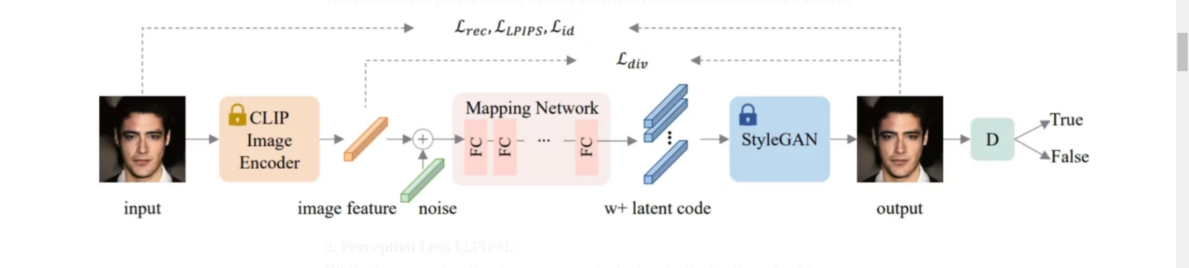
Method-1: CLIP2GAN
Generator
Discriminator
CLIP Embeddings
The generator learns to produce high-quality images by gradually increasing the resolution of the generated images.
The discriminator's role is to distinguish between real images from the CelebA dataset and fake images generated by the generator.
CLIP's powerful text encoder is used to extract semantic features from text descriptions, enabling the model to understand and generate images based on the text input.

Slide 4






Loss Functions
Reconstruction Loss
Learned Perceptual Image Patch Similarity
Adversarial Loss
Identity Loss
Diversity Loss

Slide 5
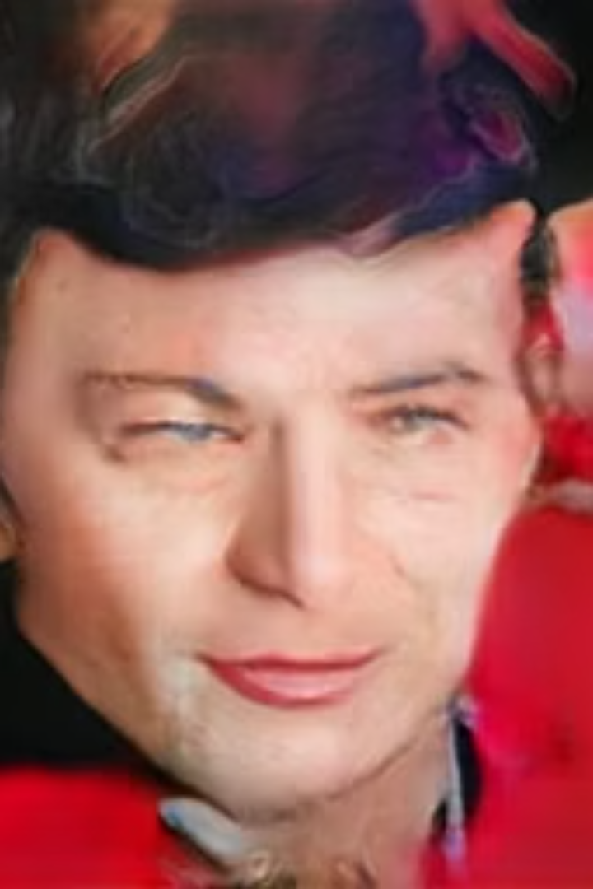
Failure: Mode Collapse
Limited Variation
Overfitting
The generator produces limited variations of outputs, often generating similar-looking images despite different text prompts.
The mapping network overfits to specific patterns in the training data, leading to repetitive outputs and a lack of diversity.
Insufficient Exploration
More experimentation is needed to solve this which was not possible due to resource constraints.

Slide 6



Method-2: CLIP2StyleGAN
StyleGAN
A StyleGAN generator is used, which allows for greater control over image generation through a style-based approach.
CLIP Embeddings
CLIP embeddings are leveraged to guide the generation process, ensuring semantic alignment between the text prompt and the generated image.
Training For every text prompt by leveraging the Clip Embeddings of the text and the generated image from the StyleGAN
3

Slide 7



Loss Function
Spherical Distance Loss
Prompts Distance Loss
Measures the angular distance between feature embeddings, ensuring semantic alignment between text and image embeddings.
Minimizes discrepancies between generated image embedding and CLIP embedding of the guiding text prompt, enhancing text-image consistency.

Slide 8

Results

Slide 9
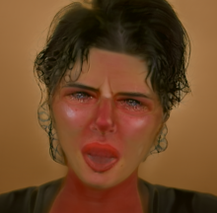


Slide 10
Multiple Prompts:

Slide 11
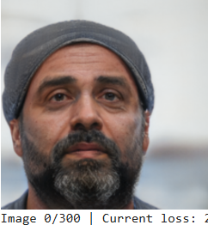


Slide 12
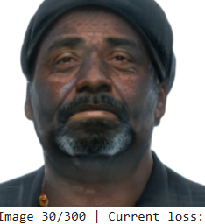


Slide 13
